Slide 1
Mind Mapping

Slide 2
If you’re tired of constantly getting lost in the thicket of ideas, half-concepts and free-floating words that emerge from your observations or brainstorming sessions, then you should think about using a Mind Mapping tool.

Slide 3
Invented by Tony Buzan.
Mind mapping is a great way to brainstorm, make a plan, or turn ideas into the steps needed to make it real.
Mind Mapping is a technique of visual representation to show relationship between various ideas, concepts or other information.
It helps in project planning, collecting and organizing data, brainstorming and presentation.
To help solve problems, find resources and uncover new ideas.
Concepts

Slide 4
Definition
“A mind map is
a visual representation of
hierarchical information
that includes a central idea
surrounded by connected branches
of associated topics”

Slide 5
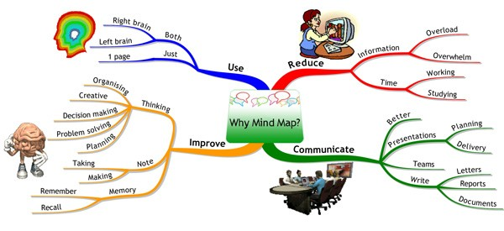
Why to Use
Mind Mapping?

Slide 6
Benefits
Helps brainstorm and explore any idea, concept, or problem
Facilitate better understanding of relationships and connections between ideas and concepts
Make it easy to communicate new ideas and thought processes
students to easily recall information
Help students take notes and plan tasks
Make it easy to organize ideas and concepts

Slide 7
How to?
All mind maps begin with a main concept or idea to which rest of the map revolves around, so choosing that idea or topic is the first step. Begin by creating an image or writing a word which represents that first main idea.
From that main idea, create branches (as many as needed), that each represent a single word that relates to the main topic. It’s helpful to use different colours and images to differentiate the branches and sub-topics.
Then, create sub-branches that stem from the main branches to further expand on ideas and concepts. These sub-branches will also contain words that elaborate on the topic of the branch it stems from. This helps develop and elaborate on the overall theme of the mind map. Including images and sketches can also be helpful in brainstorming and creating the sub-branch topics.

Slide 8
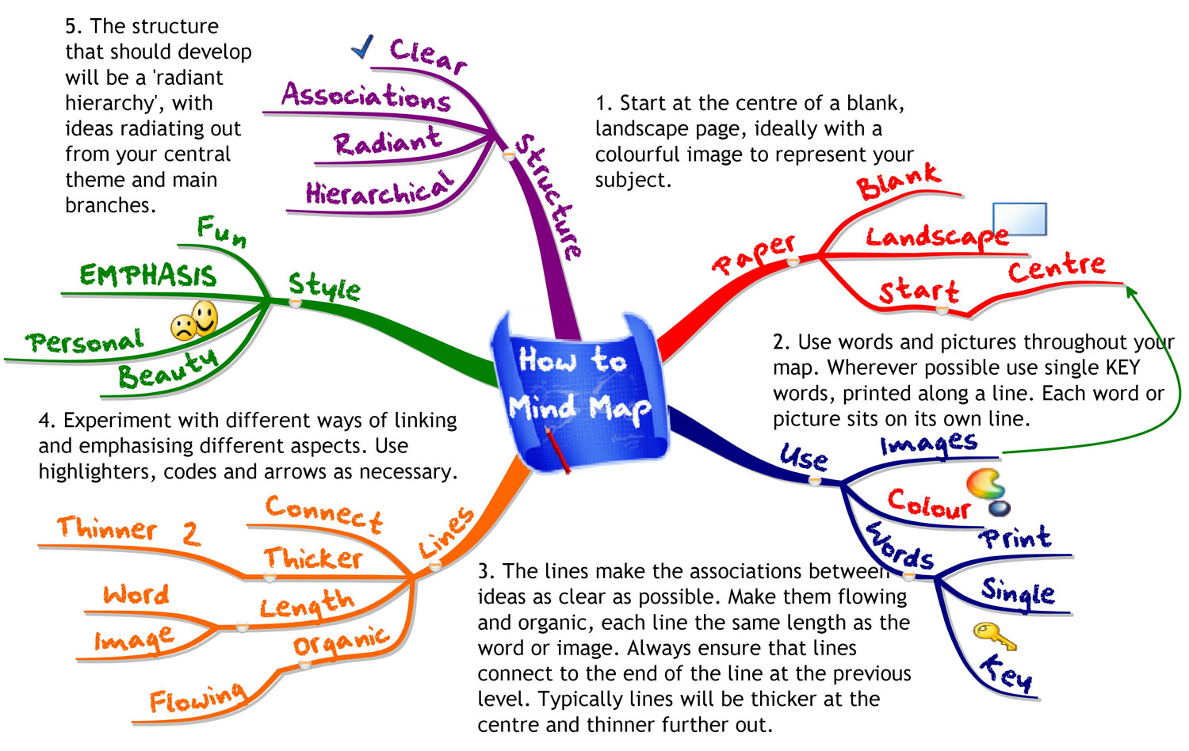

Slide 9
Types of
Mind Map
Information Mind Map
Concept Mind Map
Application Mind Map

Slide 10
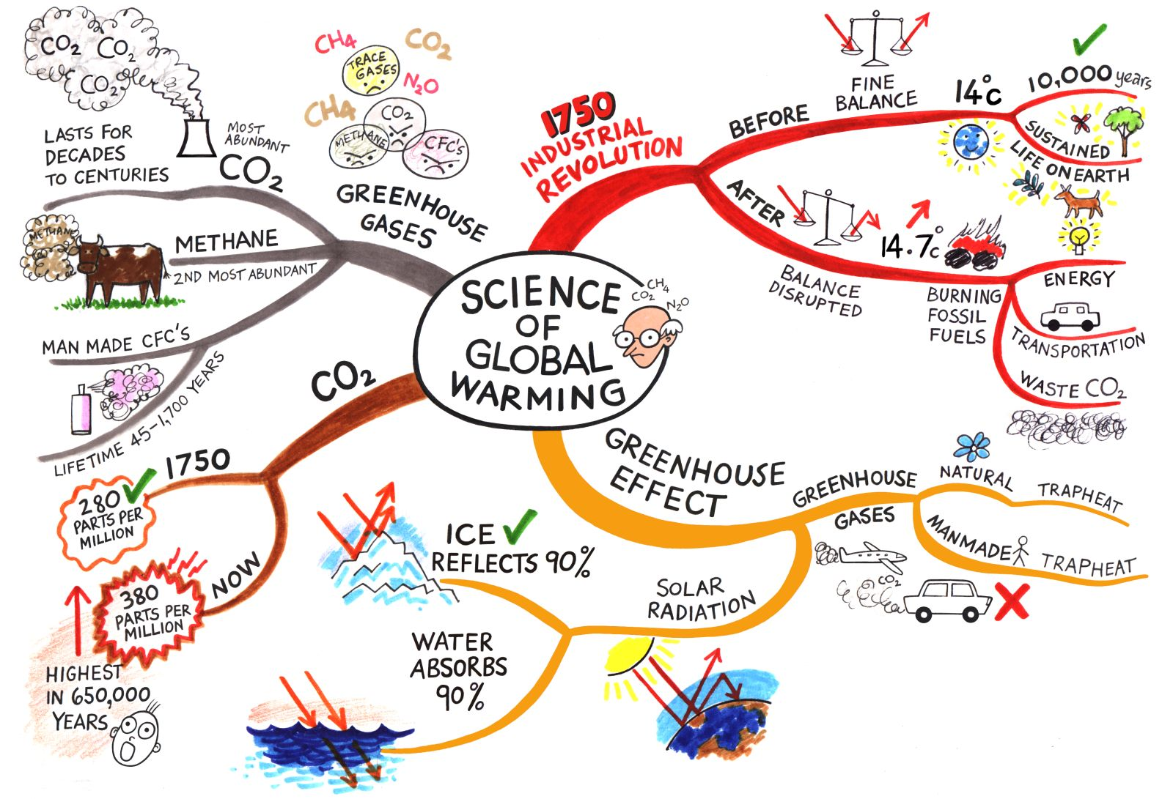
Information Mind Map

Slide 11

Concept Mind Map

Slide 12
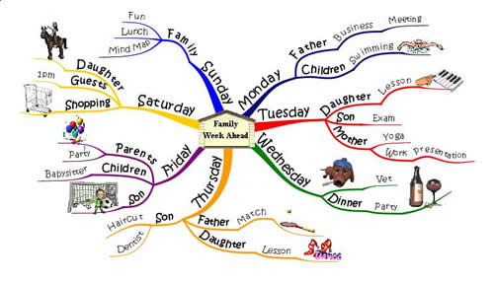
Application Mind Map

Slide 13
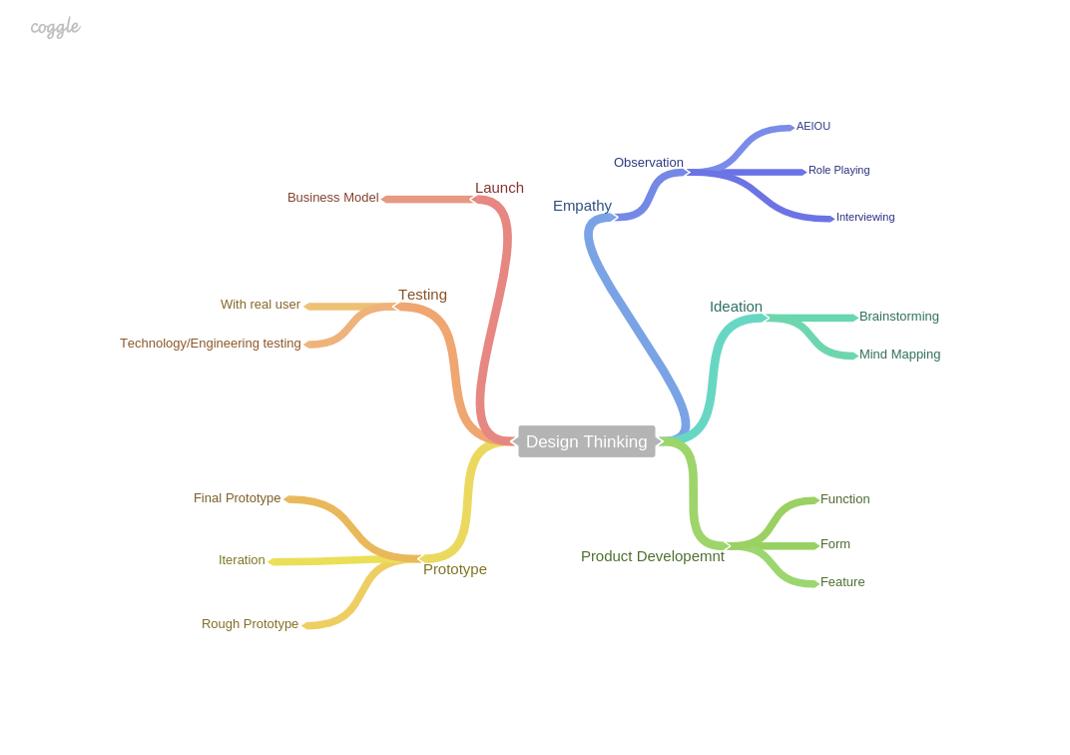

Slide 14

Example

Slide 15
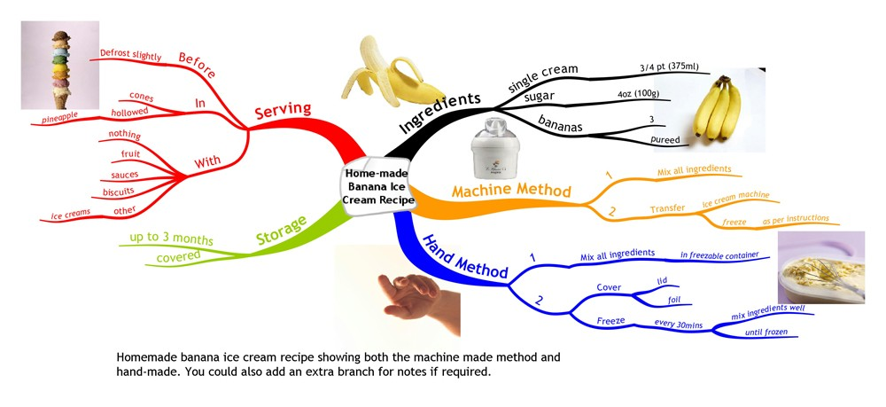

Slide 16
Thank you

